Slide 1
Making of In House Cell Panel
[How to prepare in house cell panel for antibody screening]
Sanmukh R. Joshi,
Lok Samarpan Regional Blood Center,
Surat
Venue: Lemon Tree Hotel, 431/1 Mithakh ali Six Cross Roads, Navrangpura, Ahmedabad-6. ph 07944232323
12.15-12.45

Slide 2
In house Cell Panel
Consider the attempts as ‘developmental steps’ in our set up
Not a classical roadway, but a wild path adopted to get what we needed the minimum
Routing blood bank serology- sample to bench work: the Pre- transfusion tests.
  Importance of ABO and Rh typing.
    Why not other blood groups (OBG)?
    What do we do to cover obg?
AST.
  a use of pooled O cells, advantage and limitation
  role of AST cells and cell panel
  construction of cell panel (reverse grouping, Ab screen & identification)

Slide 3
Pre-Transfusion Compatibility Tests
Pre-transfusion steps:
  Identity of the patient and the donor.
  Review of the past transfusion records of patient.
  Performing ABO and Rh.D grouping.
  Screening for unexpected antibody.
  Cross-matching between the patient and the donor.
  Re-identification of patient/ blood before transfusion.
For a safe blood transfusion all the 6 steps needs to be addressed.
Steps 3-5 are referred to as the compatibility test.
Sept12

Slide 4
Antibody Screening
In reverse ABO grouping
Detecting expected/regular/ typical antibodies to A and B antigens; helps confirming the forward grouping
In house, we use pooled A and B red cells
  3 donors’ each of group A and B are washed separately in saline, then pooled group-wise to make 5% suspension
Commercial cells supply
  has a single donor of A₁ and B cells; both being Rh.D neg to avoid interference of anti-D, if present.
  Also, supply A2 cells to identify anti-A₁ if detected.
The cells are re-suspended in diluents having EDTA to prevent haemolysis in reverse grouping, if serum is fresh.

Slide 5
Antibody Screening Test (AST)
ABO and Rh grouping is performed as routine pre-transfusion test to select homologous blood for transfusion.
Red cell typing for other blood groups (OBG) is not routinely done, so homologous blood for OBG is not selected for transfusion.
Antibodies to antigens of the OBG are not regularly occurring yet some may prove clinically significant.
AST is aimed to detect such irregular/ atypical/ unexpected antibodies to OBG
0.3-2 % of the people have a presence of irregular antibody to antigens of the OBGs

Slide 6
Antibody Screen Cells
A use of ‘selected’ screen cells is meaningful and an ideal approach in antibody screening for irregular antibodies.
Selection criteria include:
  Group O: because naturally occurring anti-A or anti-B should not interfere with detection of unexpected antibodies.
  To cover the RBC phenotype for most common antigens, e.g. D, C, E, c, e, M, N, S, s, P₁, Leª, Le ^{b}, K, k, Fyª , Fy ^{b}, Jkª, Jk ^{b}.
  Have homozygous expression of certain antigens
    helps detecting weakly reacting antibodies showing dosage-effect
  Have a set of at least 2 donors’ RBC samples
    If one of the sets lacks any of the antigens, the other one must have it.

Slide 7
Commercial screen cells
Available under different names, e.g. Selectogen I and Selectogen II
Antigram listing the antigen make up of each RBC sample
  provided with lot (batch) number by the manufacturer
  the lot number on the screen cells sample must matches with that on the antigram
Limitations:
  Rare antigens (f <1%, like Luª, Kpª, Inª) are not included in the screen cells,
    antibodies to those are not detected by routine AST.
  Antibody may be missed in AST if its concentration drops below detectable limit.
    Particularly antibody showing dosage effect, with heterozygous

Slide 8
Antibody Screen Cells
In house, we use gr O pooled red cells to detect irregular antibodies and is in practice for a long time.
Red cells from 3 gr O donors are washed separately and pooled to make a 5% suspension of each.
  Presumed to cover the most common antigens of different blood groups in this random cells pool.
It is a ‘blind’ approach
  Homozygous antigen profile may not be ensured
  A weak antibody that show a dosage effect may be missed

Slide 9
Commercial screen cell Panel….
Two or three cell-suspensions from individual donors for antibody detection in the patients, or
One cell suspension, pooled from 2 or more donors for the antibody screening in donors
    Why this discrimination from the patients and the donors is a question unsolved for me!

Slide 10
Antibody Identification (AbID) Test
Once detected, the antibody need to be identified
To determine antibody specificity (name)
To determine clinical significance
To ascertain if antibody could cause HTR
Help selecting appropriate antigen-neg blood for transfusion
Important for investigation for monitoring the episode of HTR/ HDN/AIHA

Slide 11
Antibody Identification: use of Commercial cell Panel
Commercially available kit with red cell suspensions of 11 group O donors, in ready-to-use fashion.
Accompany the antigram with lot number showing the antigen make up of each RBC sample
It is important to match the lot (batch) number shown in antigram with the lot number on the cell panel.
Three sets of panel designated as A, B and C for their specific use.

Slide 12
Commercial cell Panel…
Panel A:
  A primary panel that provides homozygosity of major blood group antigens,
  Allows identification through differential reactivity of frequently encountered single/ multiple antibody combinations.
Panel B:
  For use in complement with Panel A to identify more difficult antibody combinations.
Panel C:
  In two sets - one untreated and another enzyme-treated

Slide 13
Commercial cell Panel….
Panel C….
  to identify weakly reacting antibodies and
  To separate mixtures of antibodies, if one is reacting with untreated cells and the other is directed against enzyme-sensitive antigens.
  Enzyme-treated red cells assist in the identification of antibodies in 2 ways:
    enhance reactivity of some Ag/Ab reaction e.g. the Rh or Kidd blood group systems
    destroy the antigens of the MNS, Duffy, IN systems

Slide 14
Commercial cell Panel….
Limitations
As the supply originates from the West, so is expensive
Expiry dates as per the manufacturing date at the source
  by the time it arrives at our place, enough days are lapsed so the effective days for the end user is limited to only few weeks.
An expensive material is of no use once expired (~FDA).
Antigens profile as per occurrence in Western population
Our region/ country specific antigens may be missed
There is a clear need to have our own cell panel for detection/ identification of antibodies in our set up.

Slide 15
In house cell panel: our First attempt
Cell typing on staff members/ students at
  BGRC, Mumbai and its surrounding institutions like KEM Hosp, Wadia Mat Hosp, Tata Mem Hosp, Cancer Res Inst., Haffkine Inst.
Using antisera available as locally identified sources/ gift
  Only limited antigens were typed, many of which ware clinically non-significant like M, N, Lewis, P₁ etc.
We had enrolled good number of people in our panel for all ABO groups but, group O being the most useful one.
Sometimes we used to face problem of mistaken identity of the donor particularly if we entrusted others to get the sample
  An interesting event of Mr. Vin and “anti-Vin” that turned out to be resolved as anti-B after extensive efforts put up for two days!!!

Slide 16
First attempt in BGRC…
No samples were frozen-preserved, collected afresh as often as required in normal saline, by finger prick.
Antibody specimens were stored until enough case were accumulated to make optimal use of cells collected
Besides reactivity with cell panel, antibody identification was guided by nature of antibody as sensitivity to temperature, enzyme, hemagglutination inhibition by soluble antigens in saliva (Lewis, H, etc), milk (I), hydatid cyst fluid (P₁).
Sometimes, we used to get a supply of rare red cells from International group called SCARF

Slide 17
In house cell panel: UK experience
I had developed a good taste on cell panel used during my work-visit to a regional blood center in the UK.
They had in house cell panel of enormous magnitude.
  So many fully typed red cells were available in store to make the “daily panel” and the “days panel”
  Daily panel being constant, the days panel varied from Monday through Sunday.
  With an antibody requiring exhaustive work up, one can test with almost 90 different red cells at any given time!
  I tested one serum with these cells that was to be anti-In^{b}
...and there I started ‘dreaming’ on making our own panel

Slide 18
An aborted attempt
Meanwhile, I moved from place to place - city to city in different countries to earn my daily ‘living’!
Once with Indian Red Cross Blood Centre, Mumbai, I was prompted to prepare a budget-proposal for in house cell panel.
  I was very happy over the suggestion.
I thought to keep a bare minimum cost to get it through.
  Only expenses for antisera amounted to ~Rs 90,000/-
The proposal was submitted just to know after a long wait that it was not to be approved for “it was too small to get!”
Then on, I thought of relying on commercial supply- albeit based on free gift, no matter it is of an out-dated kind!

Slide 19
In house cell panel: Current Set up
Choose group O+ and O- regular donors
First, to test for rare antigens.
Antisera to be used in utmost conservative manner
  ‘saving close’ to be exercised
After reading the results, the test supernatant was aspirated for reuse in further screening in parallel to a pos control
  3/70 random gr O red cells tested with anti-E
  2/67 Tibetans samples tested with anti-Diª
  5/212 O, Rh neg cells were tested with anti-Inª
Besides, random donors at LSRK were screened for antigens Diª, Miª, Mur and all of them lacked these rare antigens.

Slide 20
Our experience
Then we tested a few random red cells for the common antigens with appropriate antisera
  a few obtained from commercial sources and
  others through the Gift.
Looked for homozygosity for certain antigens that usually show the dosage effect, e.g. Jk, MNSs, C, E, Fy etc.
The following chart shows antigram on the in house cell panel we made.

Slide 21
Coombs Control Cells
Sensitized with lgG ant-D to check false neg AHG results.
Difficult to procure anti-D for preparation of the red cells.
  In face of saline reacting monoclonal anti-D, no paid donors are immunized now a days
  In an advent of RhIg being used to prevent the Rh-sensitization, no natural IgG anti-D is available
I have developed an unique strategy:
  In Rh-HDN treatment of exchange transfusion, ask the doctor to collect the baby’s first two blood aspirates and send us
The baby’s plasma + ether-eluate prepared from the baby’s red cells are pooled and used as a source for anti-D.
The anti-D augmented gives beautiful sensitized red cells!

Slide 22
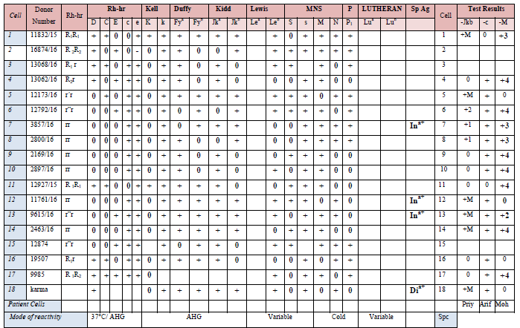
AbID cell panel

Slide 23
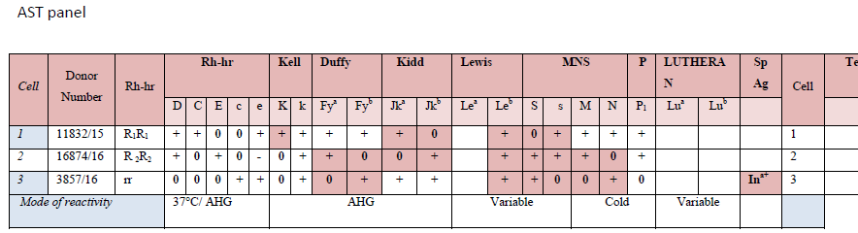

Slide 24
In house cell panel: storage in frozen
We preserve these cells in frozen state (in glycerol citrate).
In 40% Glycerol-citrate solution taking
  60 parts 3.8% tri-sodium citrate solution + 40 parts glycerol;
  Shake well to mix the content
Packed red cells and the glycerol citrate solution were mixed in equal quantity and kept under roller-mixer device (VDRL-Shaker is good enough) for one hour.
Distribute the glycerolized red cells in smaller aliquots and store at -25°C

Slide 25
In house cell panel: Reconstitution for use
Reconstitute the cells by washing them in solutions of gradually reduced glycerol content.
Prepared serial dilutions of 40% Glycerol in 3.8% citrate
Mixed the thawed red cells in Tube 1, centrifuged, decant ed the supernatant and added/ mixed the next dilution and like-wise washed the red cells till the 5th tube.
Give one more wash with normal saline.
Tube 1 | Tube 2 | Tube 3 | Tube 4 | Tube 5
citrate | citrate | citrate | Citrate + saline | saline
40% Glycerol | 20% Glycerol | 1 0% Glycerol | 5% Glycerol | 2.5% Glycerol
20% Glycerol | 1 0% Glycerol | 5% Glycerol | 2.5% Glycerol | 1.25% Glycerol

Slide 26
In house cell panel: Liquid storage solution
Once reconstituted, the red cells are suspended as 5% in the
following preservative solution to store and use for 2 months
Formula:
Trisodium Citrate Dihydrate | 8 g/L
Sodium Chloride | 4.2 g/L
Dextrose | 20.5 g/L
Inosine | 0.4 g/L
Adenosine Triphosphate (ATP) | 0.4 g/L
Chloramphenicol | 0.4 g/L
Neomycin Sulphate | 0.1 g/L
Water

Slide 27
Acknowledgement
Hungary Blood Transf Center, Budapest for anti-K, -Diª
Japanese Red Cross Blood Center for anti-Diª, -Miª, -Mur
New York Blood Center, for anti-Fyª, Fy^{b} -S,-k, -Jkª, Jk^{b}, -Di^{b}
Ortho Clinical Diagnostics for anti-s

Slide 28
Thank you!

